Slide 1

WEB PROJECT - SKKU BOOK MARKET -
SWE3048_43
KIM HO JIN (2016314786)

Slide 2
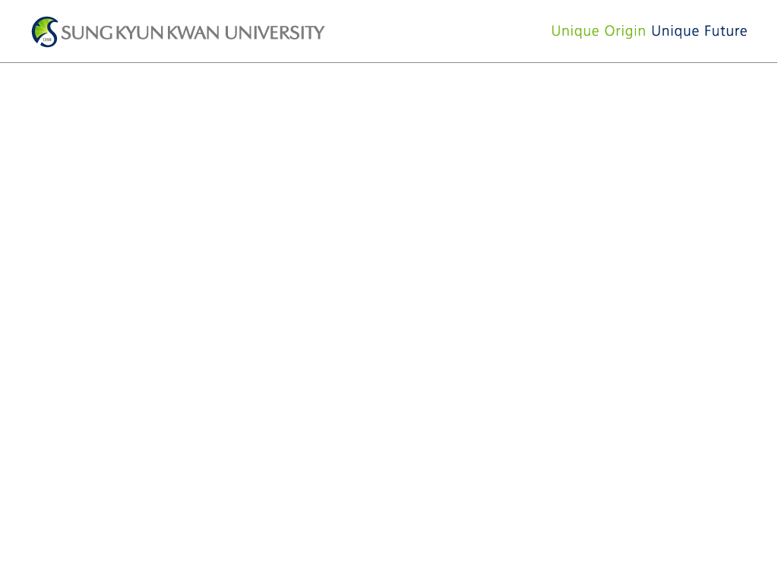

Home Page
This is the first page you meet when you run the website.
You can choose user type as seller or buyer with buttons.

Slide 3
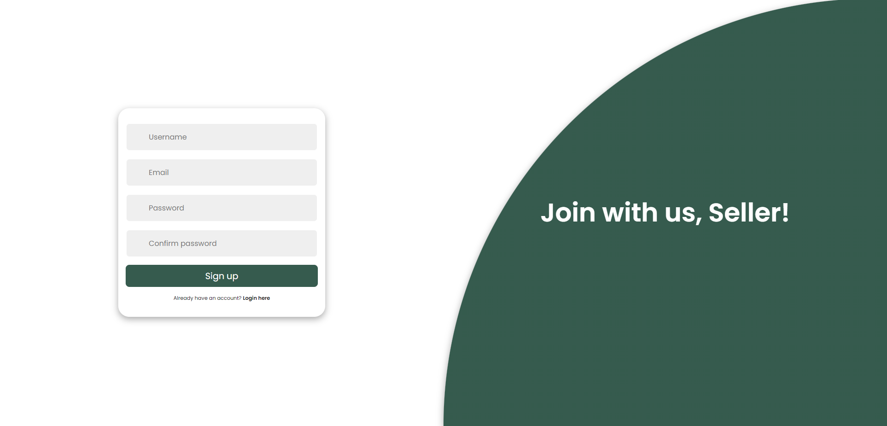

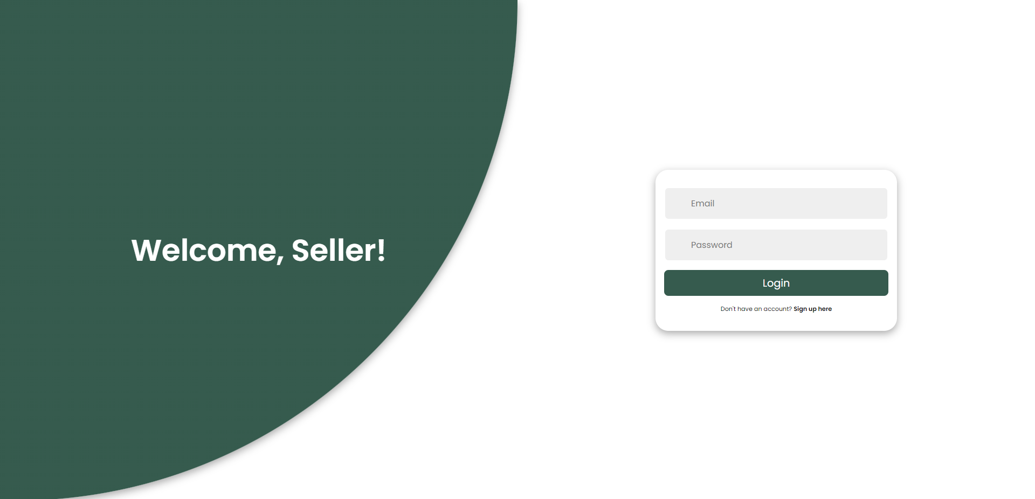

Sign-Up & Login Page
If the user succeeds in sign-up, the account is created and stored in the database.
If the user succeeds in login, the user can move to main page as their user type (seller or buyer).

Slide 4

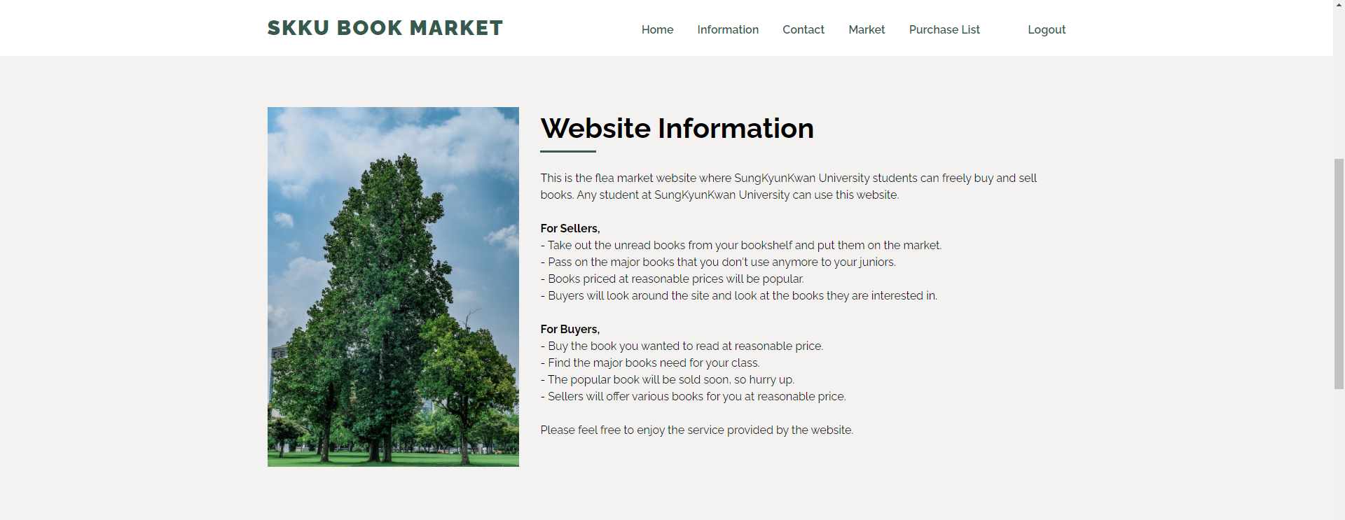
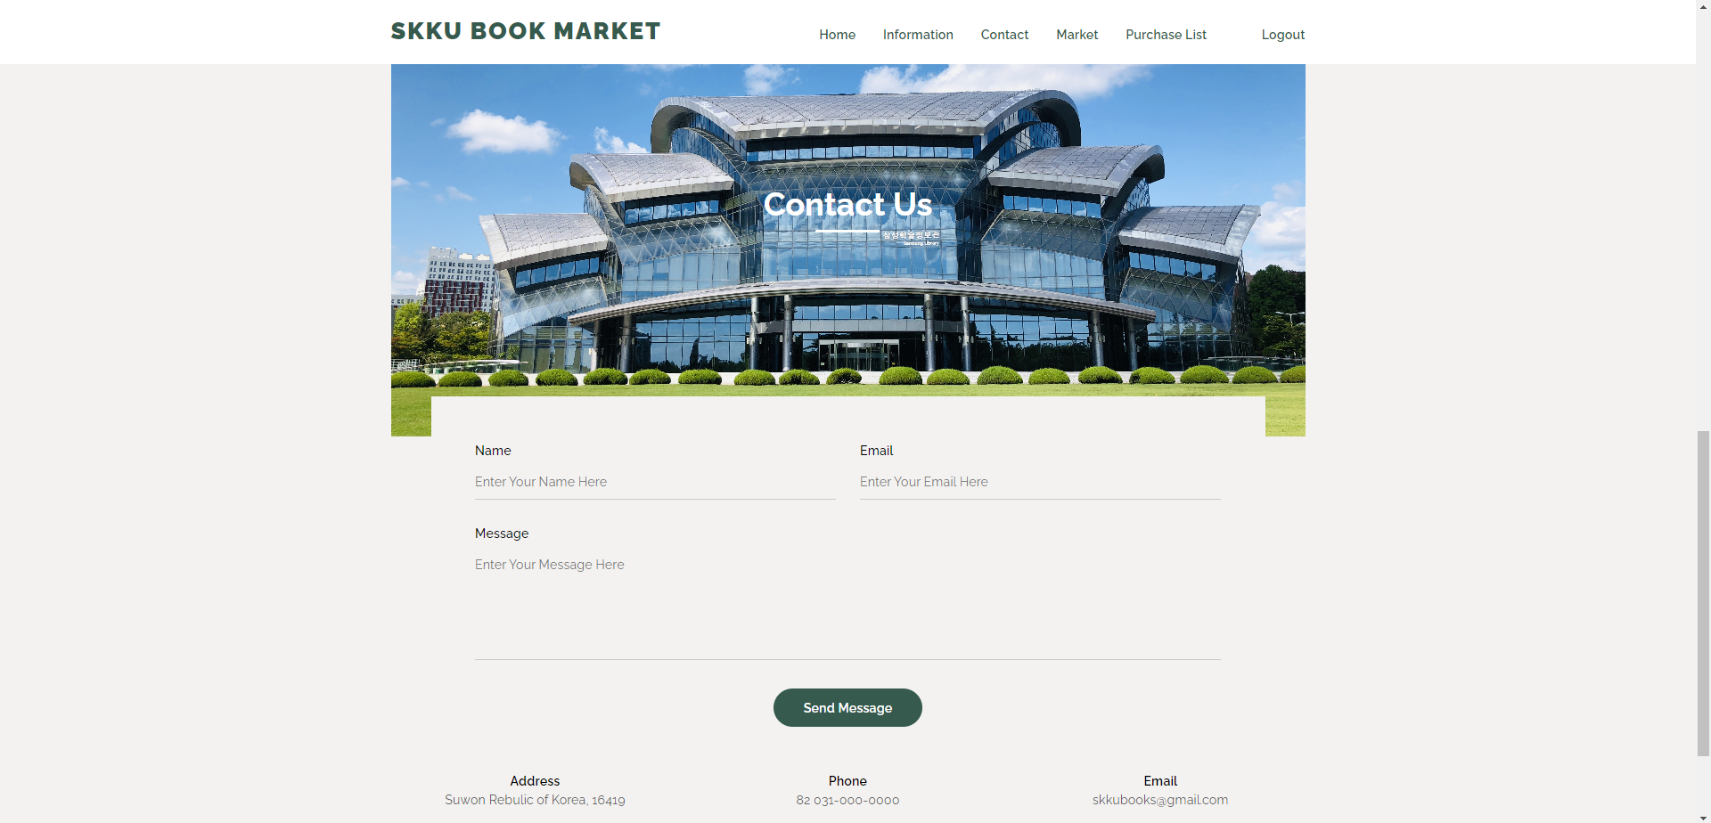
Main Page
The main page consists of banner section, information section, and contact section.
The user can move to other sections and pages from the navigation bar.
In the banner section, posters of popular or recommended books appear in slide format. The slide basically goes over automatically, but the user can also turn it over himself.
In the Information section, the user can find out the purpose of the website.
In the contact section, the user can contact website developer by leaving a message. These messages are store in the database.

Slide 5
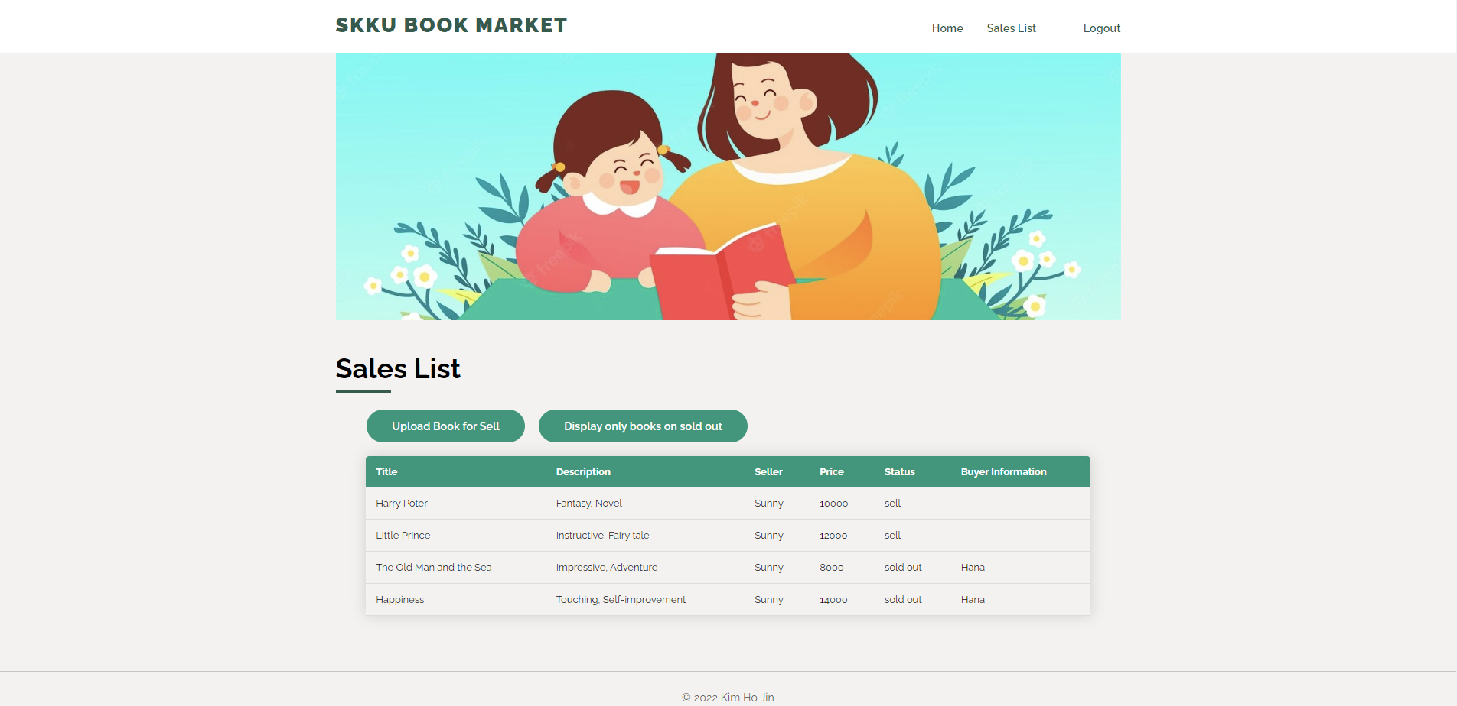
Sales List Page (for Seller)
Sellers can see all the information about the books they put on the market.
When the seller clicks the category title of the sales list table, the program sorts the table in ascending or descending order based on the column value.
‘Upload Book for Sell’ button loads the upload page.
‘Display only books on sold out’ button loads the sales complete list page.

Slide 6
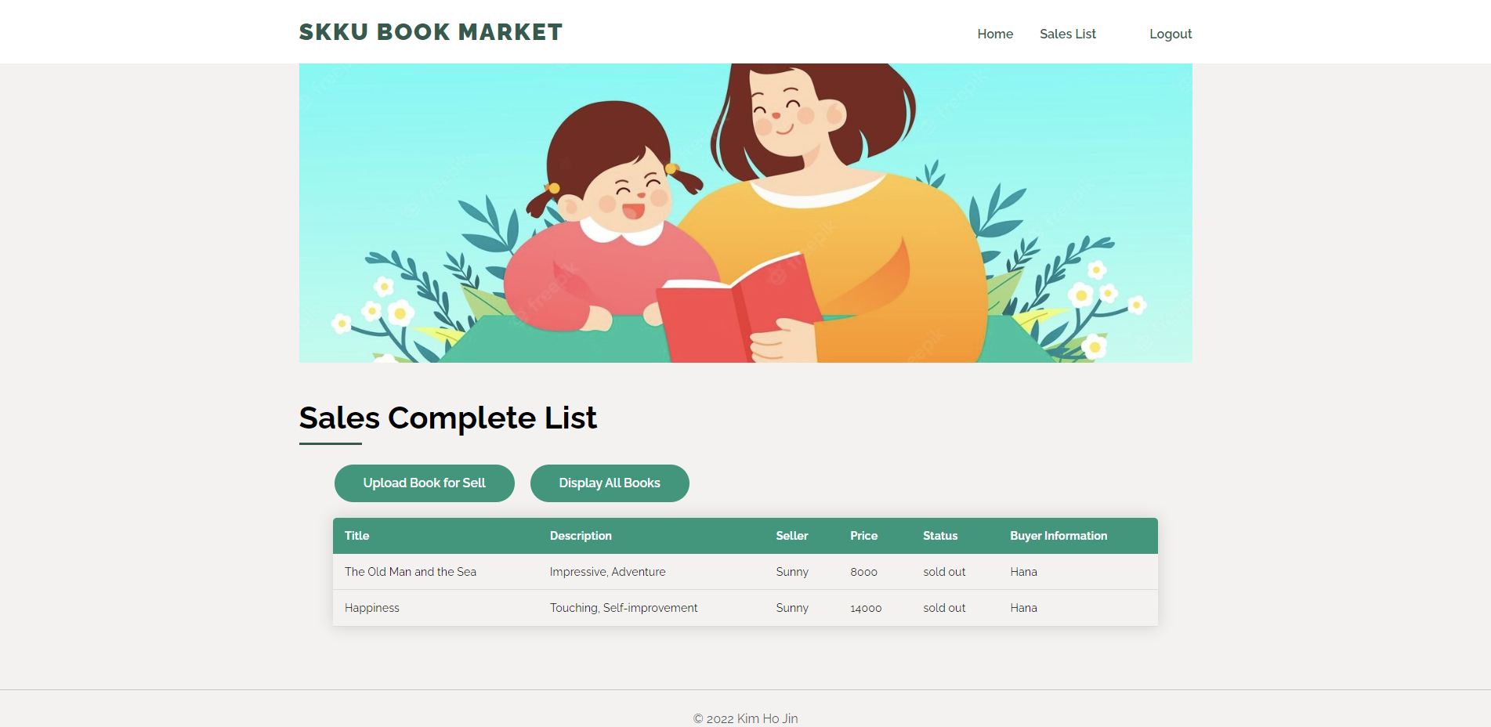
Sales Complete List Page (for Seller)
Sellers can see all the information about the sold book.
When the seller clicks the category title of the sales list table, the program sorts the table in ascending or descending order based on the column value.
‘Upload Book for Sell’ button loads the upload page.
‘Display All Books’ button loads the sales list page.

Slide 7
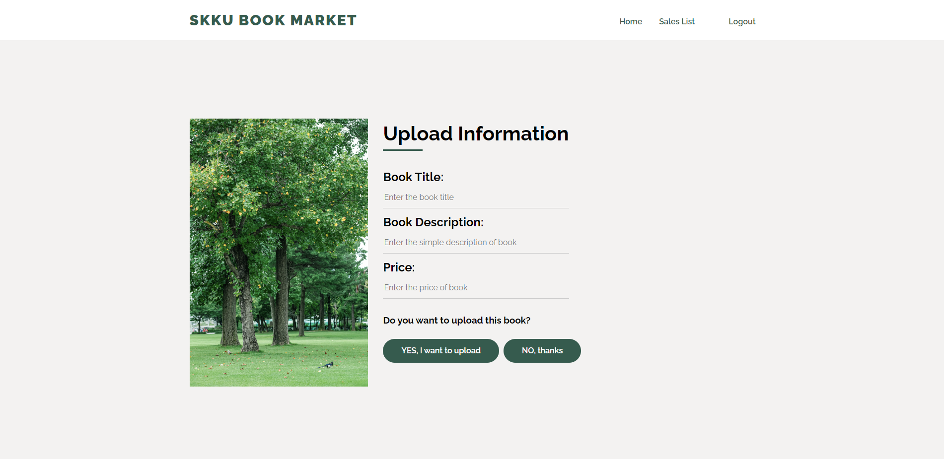
Upload Book Page (for Seller)
On this page, the seller can upload the books to sell.
When the upload of the book is successful, the book information is reflected in the database.

Slide 8
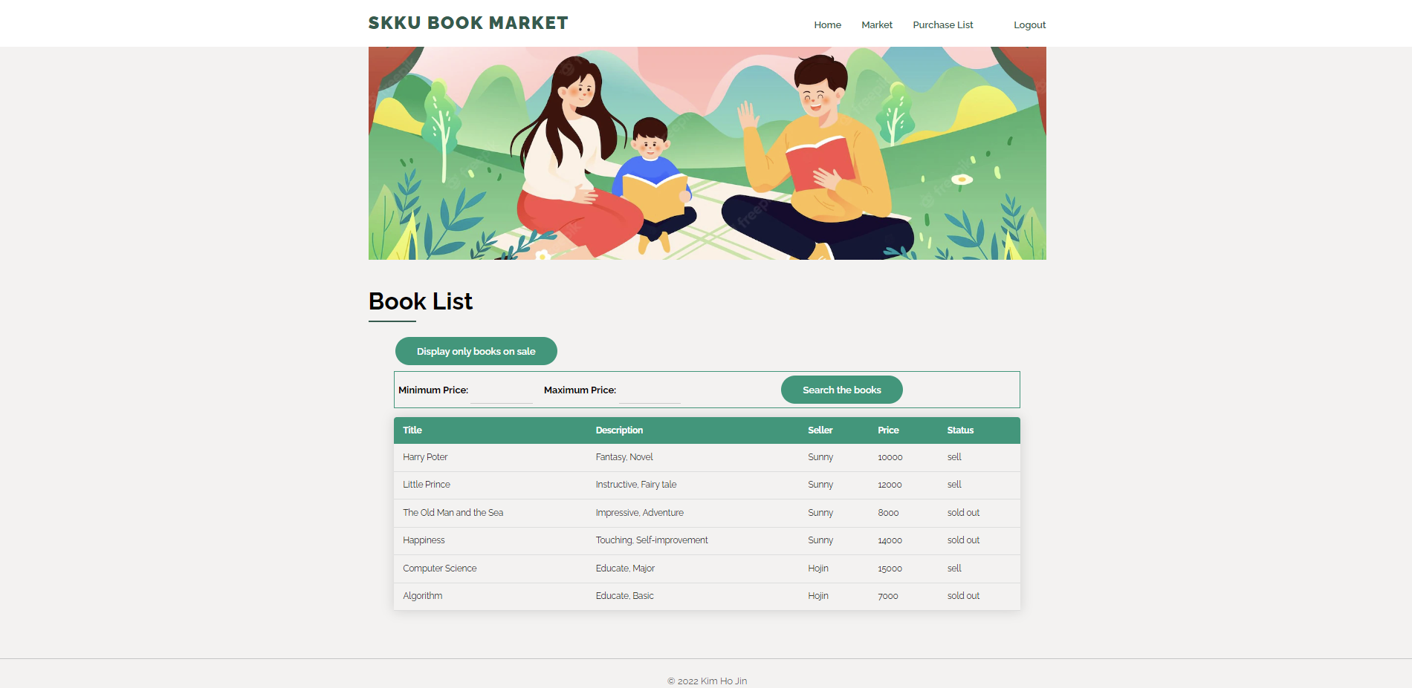
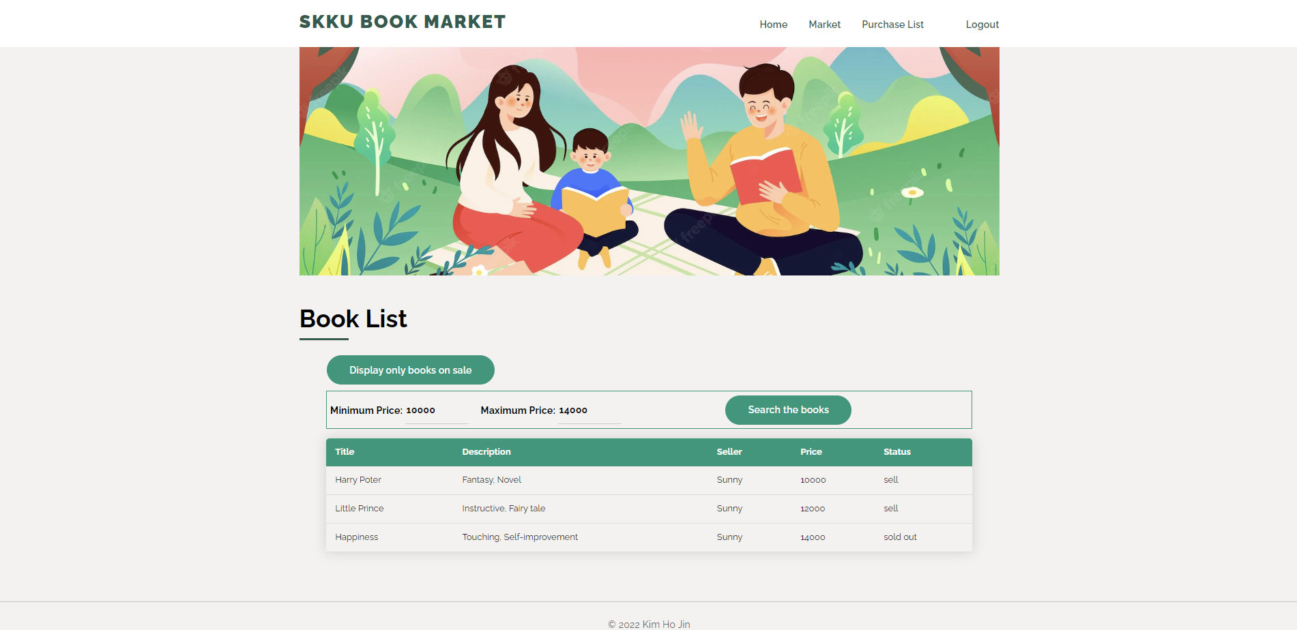
Book List Page – Display all books on market (for Buyer)
On this page, the buyer can see all books information on the market.
When the buyer clicks the table row for purchase and its status is ‘sell’, the purchase page will be shown. The buyer can check the book information on this page and proceed with the purchase.
Buyer can search the book by price. The buyer can set minimum and maximum price in search section.
‘Display only books on sale’ button loads the book list page that displays only books on sale.

Slide 9

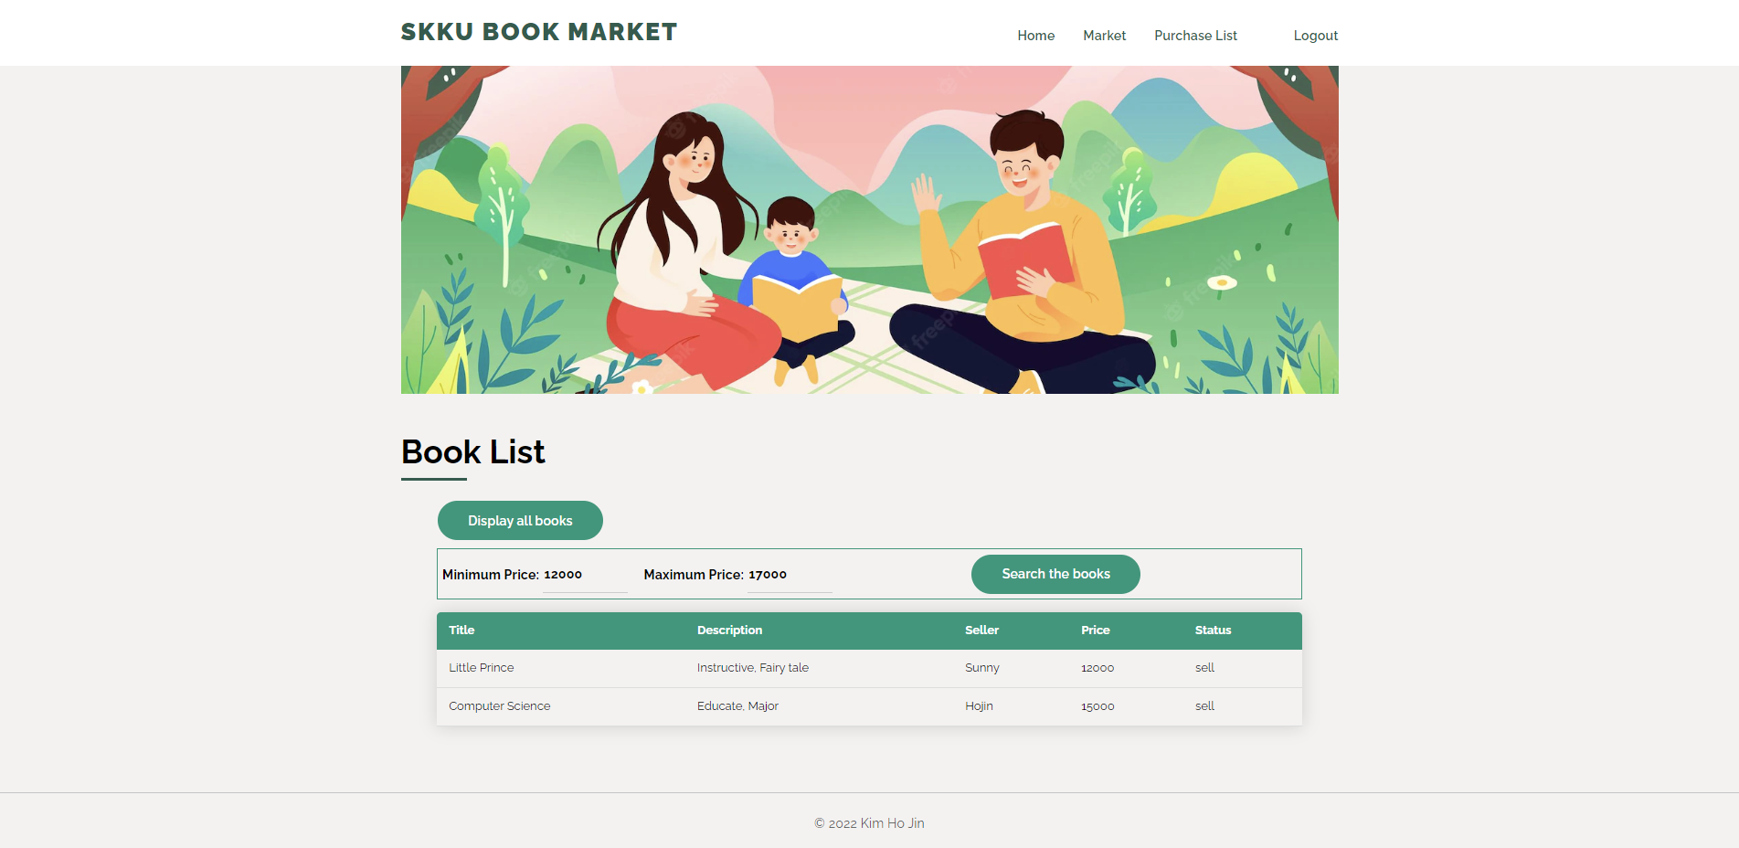
Book List Page – Display only books on sale (for Buyer)
On this page, the buyer can see only books information on sale.
If the buyer clicks the table row for purchase, the purchase page will be shown. The buyer can check the book information on this page and proceed with the purchase.
Buyer can search the book by price. The buyer can set minimum and maximum price in search section.
‘Display all books’ button loads the book list page that displays all books on the market

Slide 10
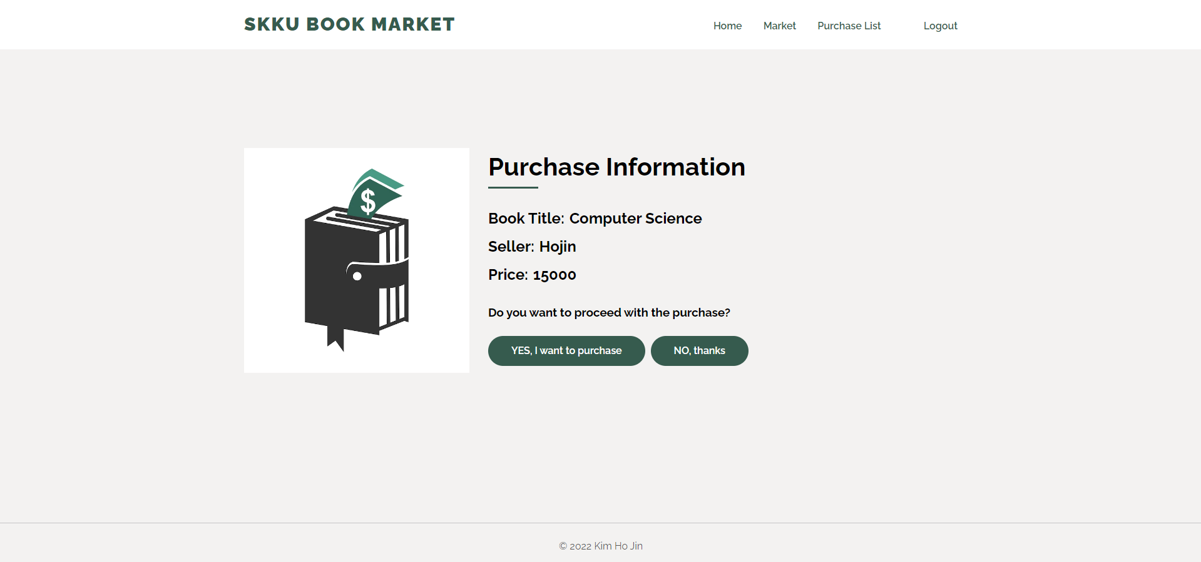
Purchase Page (for Buyer)
If the buyer clicks the table row on the book list page, this page will be shown the selected book information. This page consists of book title, seller name and price information.
The buyer can purchase the book by clicking the ‘yes’ button. When the buyer purchases this book, the book status will change to ‘sold out’ and reflect the buyer information. Also, the database will be changed.

Slide 11
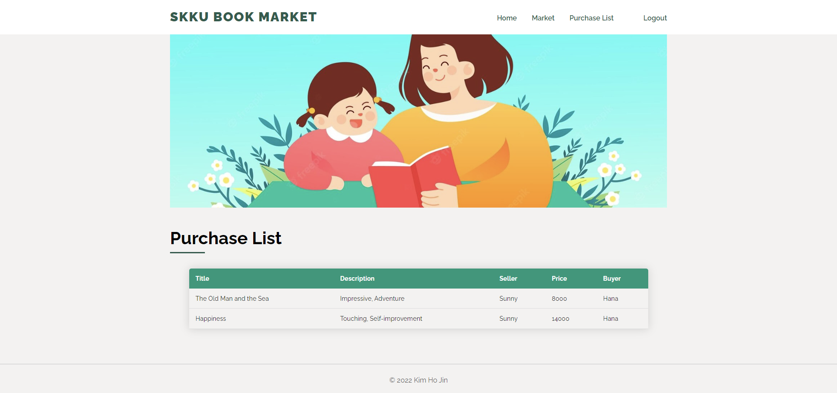
Purchase List Page (for Buyer)
On this page, the buyer can see all books information they have purchased.
When the buyer clicks the category title of the purchase list table, the program sorts the table in ascending or descending order based on the column value. The price is sorted numerically and the rest are sorted alphabetically.

Slide 12
Thank you!

